Slide 1
Direct Research Report A generator for edge control path
Huayu Fu

Slide 2
Objective
Design a python code to generate control path, able to control multiple divided clusters, and the code can take user defined controller info as input.
Note: We have token and non-token click controller pre-defined. By combining them into one, namely control path, we have it ready for relative timing constraints.
Motivation
Increase the performance for the linear pipelined clusters

Slide 3
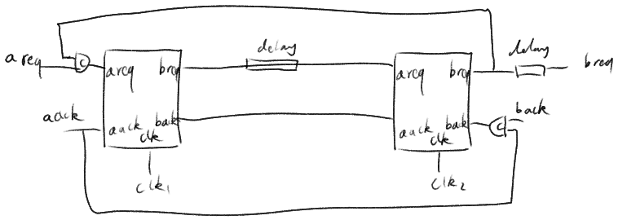
Original
Notes:
Add a tile.

Slide 4
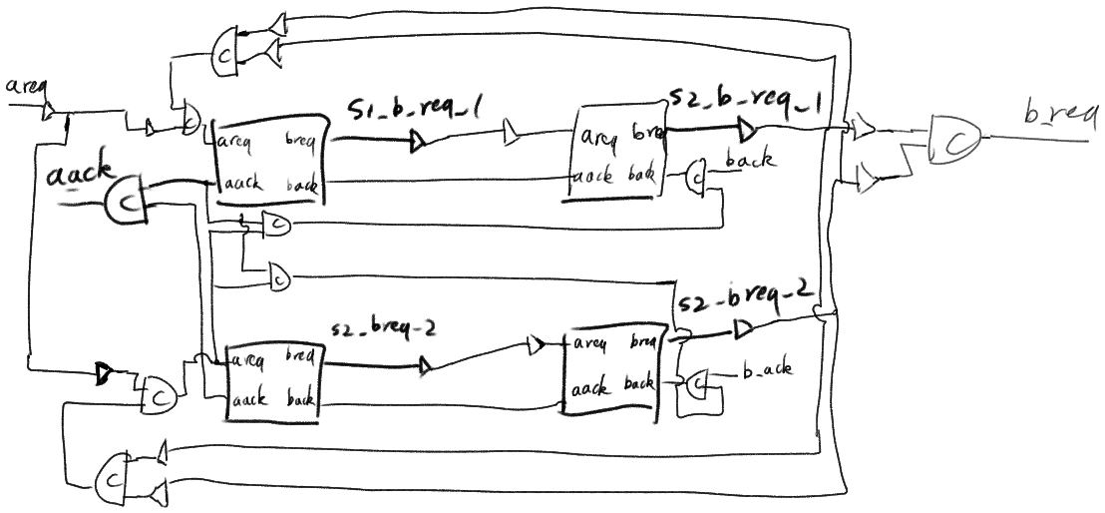
Generated by ctrl_path_gen.py

Slide 5
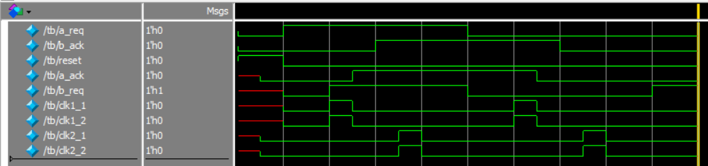
Simulation Result

Slide 6
The code
Input file :
ctrl_path.template, which has control path structure from Edge1.0.1
Input Command:
-m number of master
-s number of slave
-p relationship of master to slave, slave to master, slave to output
Check: Verify the functionality of controller using Questasim
Note: I forced dummy buffer into 0.5 ns delay from input to output, in order to run simulation. Dummy buffer has no delay in Edge flow.
Output: Verilog file of controller path, which includes multiple non-token controllers for master clusters, and token controllers for slave clusters.

Slide 7
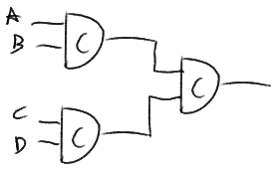

One quirk – build the balanced c-element tree
l=list of all input
while len(l)>1:
level+=1
length=len(l)
if(length==2):
connect the top c-element
l=[]
else:
nl=create new list of the intermediate wire names
out.write('wire %s;\n' %','.join(nl)) # define wire new in Verilog file
if(length%2==1): # if length is odd add the last element of l to nl
nl.append(l[-1])
pop 2 input from l and connect them to c-element and output connect to the wire in nl
l=nl
Generate a tree
Instead of a chain
Notes:
YZ: Make it clear The title is hidden under pictures

Slide 8
Further improvement
Share the common resources
Define more reasonable names inside control path
Can be combined
Notes:
YZ: How to combine them?

